Slide 1
Challenge 3
Group 5
Iris, Dave, Ray, Aaron, Shen

Slide 2
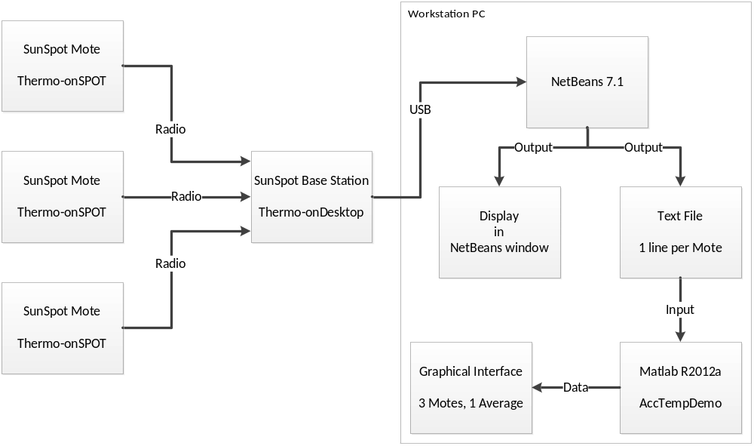
Architecture

Slide 3
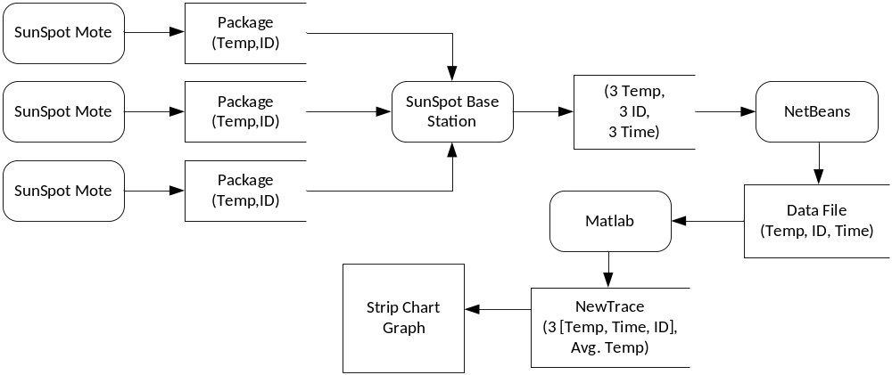
Data Flow

Slide 4
Demonstration of solution
See Laptop setup.

Slide 5
Java Code
rCon.receive(dg);

Slide 6
Matlab Code
hLine2 = plot(x,y);
StripChart('Update',hLine2,newTrace(i).tempC);
xlabel('time/milisecond');
ylabel('temper C');
title('time-temper');
legend('id=358f','id=465e','id=437c');

Slide 7
Sample of the Output
[java] SunSPOT:0014.4F01.0000.358F,1348635036247,30.4,86.72,
[java] SunSPOT:0014.4F01.0000.465E,1348635038740,30.4,86.72,
[java] SunSPOT:0014.4F01.0000.358F,1348635036484,30.7,87.25,
[java] SunSPOT:0014.4F01.0000.465E,1348635038977,30.4,86.72,
[java] SunSPOT:0014.4F01.0000.358F,1348635036723,30.1,86.18,
[java] SunSPOT:0014.4F01.0000.465E,1348635039218,30.4,86.72,
[java] SunSPOT:0014.4F01.0000.358F,1348635036966,30.7,87.25,
[java] SunSPOT:0014.4F01.0000.465E,1348635039457,29.8,85.64,
[java] SunSPOT:0014.4F01.0000.358F,1348635037210,30.7,87.25,
[java] SunSPOT:0014.4F01.0000.465E,1348635039694,30.7,87.25,
[java] SunSPOT:0014.4F01.0000.358F,1348635037449,30.4,86.72,
[java] SunSPOT:0014.4F01.0000.465E,1348635039933,30.1,86.18,
[java] SunSPOT:0014.4F01.0000.358F,1348635037695,30.7,87.25,
[java] SunSPOT:0014.4F01.0000.465E,1348635040170,29.8,85.64,

Slide 8
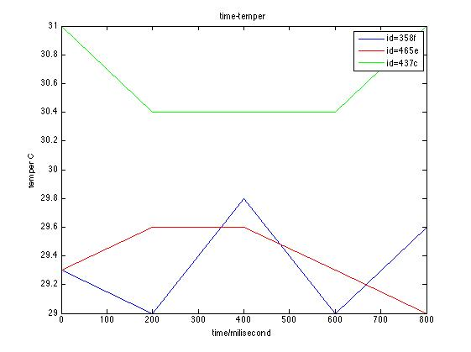
Graphic user interface in Matlab

